Slide 1
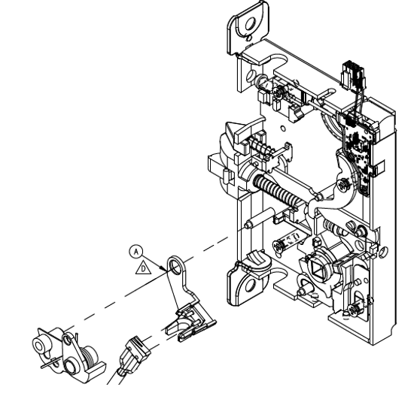
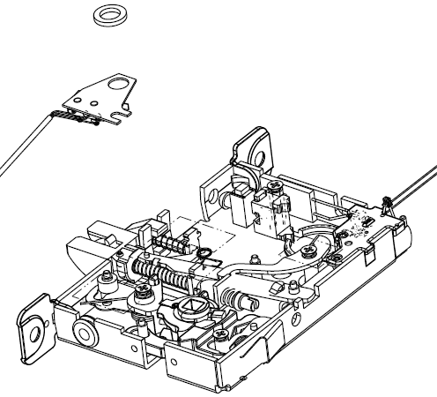


LV RX Switch Wire Colors
Black => Green
Blue => Blue
Yellow => Yellow
Effective 2/10/2026
Old Design: RX switch holder sits on top of the lock components. Rubber grommet used for wire exit.
New Design: RX switch holder sits under the fire fuse assembly. Holder “A” has a built in “grommet”. RX switch triggered off the retractor crank shown in red. Wire colors now match the standard L9000 RX switch.

