Slide 1
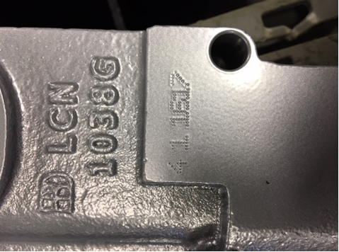

2030/5030/6030 Stamp Format
Stamp Configuration
2030 Sample
Blank Space
1 1 1517
Size
Shift
Year
Week
Size Range: 1, 2, 3, 4, 5, 6
Shift Range: 1, 2
Week Range: 1 through 52
Year: 2 numbers

